Slide 1
Mini Project Presentation
Water Level Indicator
PF47_Pragati Umate

Slide 2
Content
Introduction
Objectives
Industry-Based Applications
Project Methodology
Component Requirements
Proposed System
Conclusion

Slide 3
Introduction
Nowadays everybody has overhead tank at their homes, but the one who has a water tank above knows the kind of problems that they face. Water tank overflow is a common problem which leads to the wastage of water. Being electronics enthusiastic made a simple and handy circuit which will detect the water level and will raise an alarm upon getting the water tank full or a preset level.This simple transistor based water level indicator circuit is very useful to indicate the water levels in a tank. Whenever tank gets filled, we get alerts on particular levels. Here we have created levels by alarms & we have added LEDs to indicate the level of water and one buzzer to indicate full level. When tanks gets filled completely we get beep sound from buzzer.

Slide 4

Objectives
To learn the working of a water indicator
Measure the water level when the circuits indicate when the tank its half and full.
To learn how to build simple circuits.

Slide 5
Industry-Based Applications
The water level indicator circuits are used in factories, chemical plants, and electrical substations and in other liquid storage systems. There are many possible uses for this simple system, examples include monitoring a sump pit (to control pump activation), rainfall detection,and leakage detection. Electronic water level circuits have the capability of alerting if there is a water leak somewhere in the factory. When the water level is too high or too low or exceeds the higher limit, it can detect the water level easily by hearing an alarm sound or from different colors of a light bulb. We can also measure the fuel level in motor vehicles and the liquid level containers which are huge in the companies.

Slide 6
Project Methodology
The circuit is designed to indicate three levels of water stored in the tank: low but not empty half and full but not overflowing. When there is no water in the tank, all the LEDs are off as an indication that the tank is completely empty. When water level increases and touches the sensor, the Red LED will glow indicating that there is water within the tank. As the water level continues to rise and reaches half the tank, Yellow LED will glow. When the water in the tank rises to full an alarm is made by the buzzer as an indication that the tank is full.

Slide 7
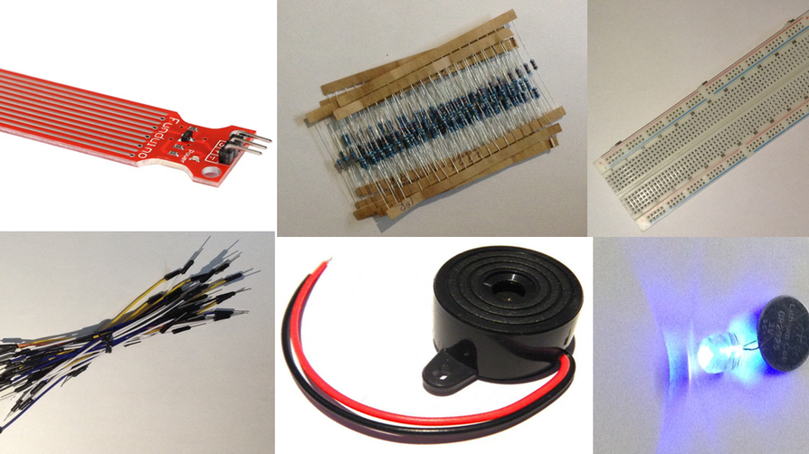
Component Requirements
Arduino Uno
Water level sensor module
Light-emitting diode (LED's)
.Buzzer
Connecting wires
Breadboard

Slide 8
Proposed System
Assemble LED on Breadboard. Red: (indicating extremely low level). Yellow: (indicating half water level). Green: (indicating full water level)
.Make Connections with Arduino and LED Make connections for LED with digital pins on Arduino. Connect the Water Sensor with Arduino.
With the Water Sensor pins you need to connect to the Arduino pins.
Connect the buzzer the positive to Digital pin 8 of Arduino and the negative to ground on the board on the negative.
After putting all components on the breadboard connected to the Arduino and making sure all components are connected students will now place the water sensor in the tank empty and thenpour the water slowly into tank.

Slide 9
Conclusion
A water level indicator with buzzer is a simple yet effective electronics project that can be used to monitor water levels in tanks or containers. The system can be further enhanced by using a microcontroller to provide more accurate monitoring and additional functionalities.A water level indicator with buzzer can help prevent overflows and ensure that water levels are maintained at appropriate levels. This can be particularly useful in various settings such as households, industries, and agriculture, where water storage and management are crucial.

Slide 10
Thank you
for listening!

